Slide 1
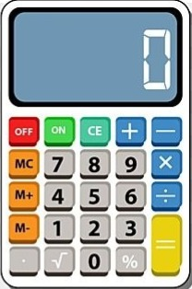
Calculator
NAME – LOKHANDE AISHWARYA
MICRO IT PROJECT

Slide 2
Introduction
What is a calculator ?
An electronic or mechanical device used for performing mathematical calculations. A calculator is a machine which allows people to do math operations more easily. For example, most calculators will add, subtract, multiply, and divide. Some also do square roots, and more complex calculators can help with calculus and draw function graphs.Smartphones and computers usually have a calculator app. Some calculators, like the abacus, will work without electricity. Others, like the electronic calculator, use batteries. A printing calculator can print its results on paper.

Slide 3
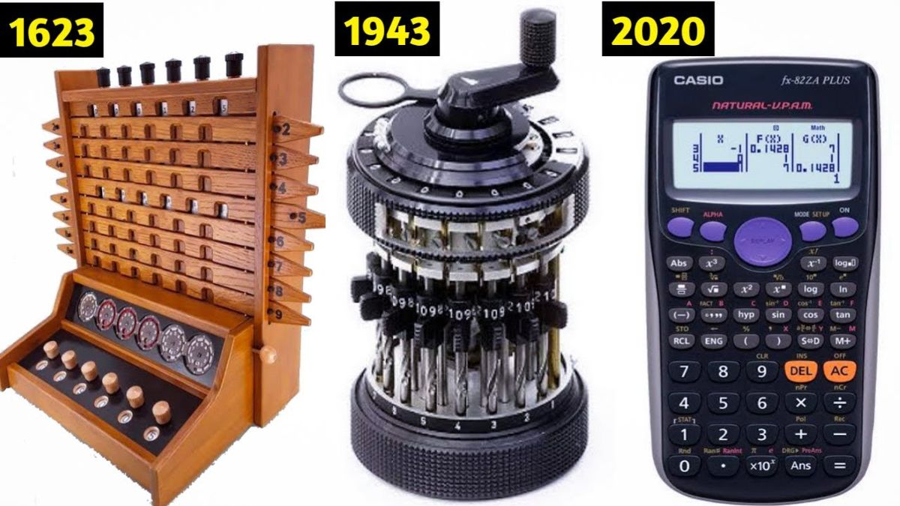
History of the Calculator
• Early tools: Abacus (~2400 BC)
• 17th century: Mechanical calculators (Pascaline, Leibniz Wheel)
• 20th century: Electronic calculators
• 1970s: Pocket calculators become widespread

Slide 4
Types of Calculators
• Basic Calculator
• Scientific Calculator
• Graphing Calculator
• Financial Calculator

Slide 5
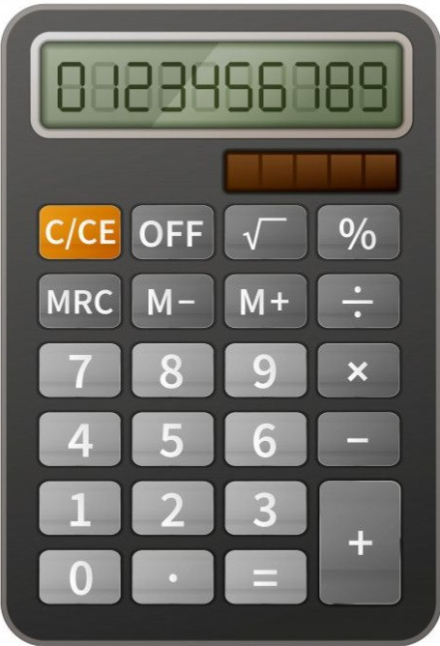
Basic Calculator
A Basic Calculator is a simple, user-friendly electronic device designed to perform elementary arithmetic operations. It is the most common and widely used type of calculator.
Four primary operations: Addition (+), Subtraction (−), Multiplication (×), and Division (÷).
Number keys (0–9) and decimal point (.).
Clear (C/AC) button to reset or clear the display.
Some models may include:
Percentage (%) function
Memory functions (M+, M-, MR, MC)
Square root (√) function

Slide 6
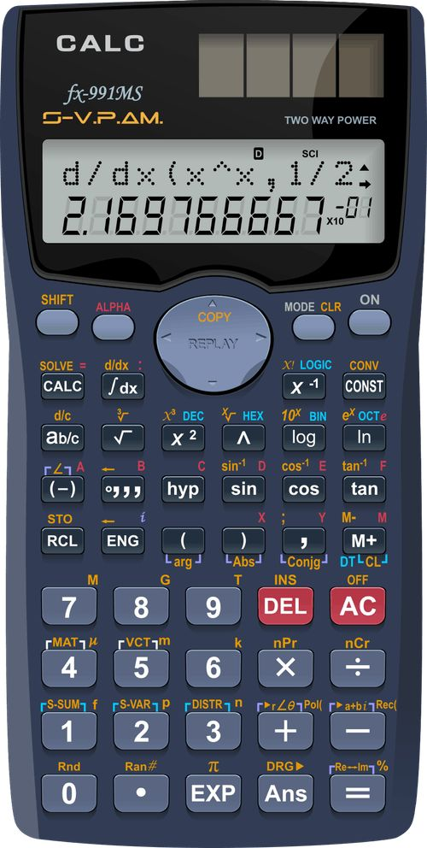
Scientific Calculator
A Scientific Calculator is an advanced type of calculator designed to perform complex mathematical, scientific, and engineering calculations that go beyond basic arithmetic.
Performs all basic arithmetic operations
Includes advanced functions such as:
Trigonometric functions: sin, cos, tan, and their inverses
Exponential and logarithmic functions: log, ln, eˣ
Powers and roots: x², xʸ, √, ⁿ√
Factorials: n!
Fractions and complex numbers (in some models)
May offer memory storage, multi-line display, and syntax recall

Slide 7
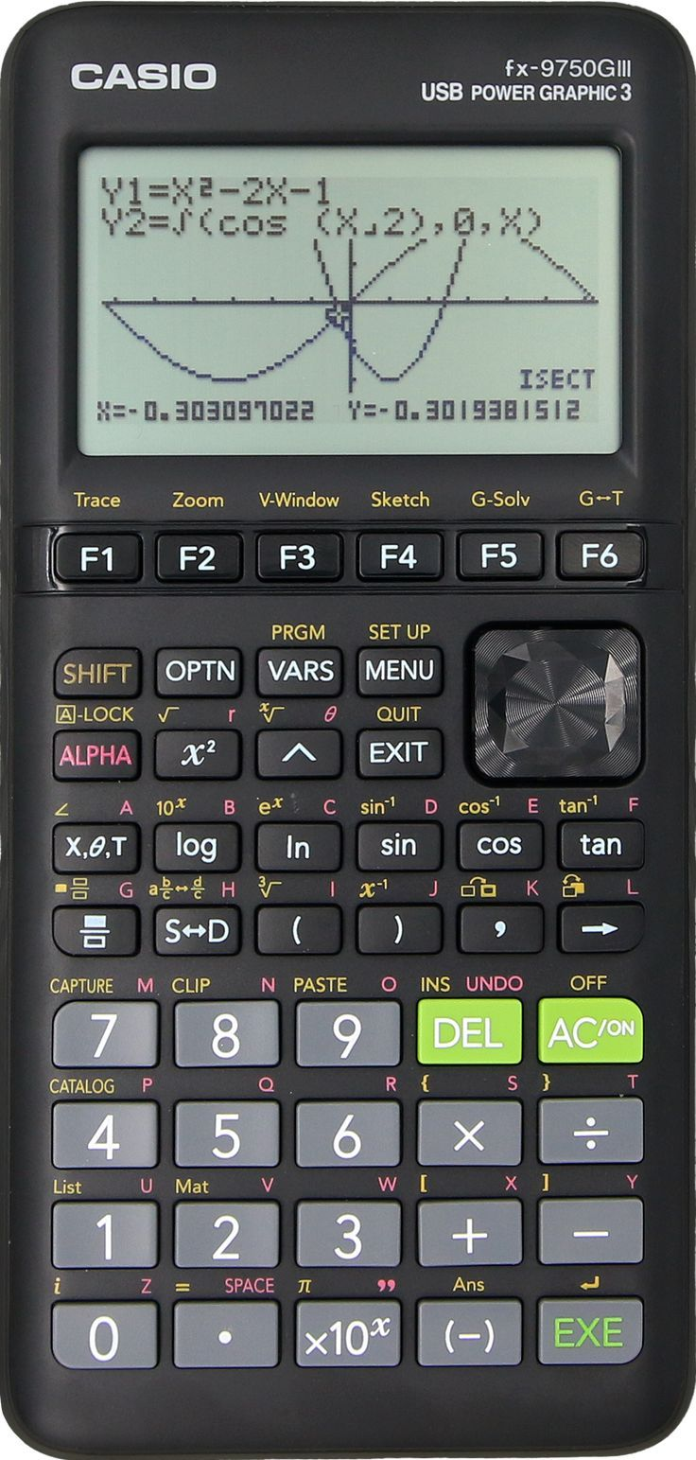
Graphing Calculator
A Graphing Calculator is a powerful, specialized calculator capable of plotting graphs, solving equations, and handling advanced mathematical computations involving variables and functions.
Performs all basic and scientific functions
Graph plotting: Visual representation of equations and inequalities
Handles: Functions of multiple variables
Matrix operations
Statistical analysis
Calculus functions (derivatives, integrals)
Programmable: Users can write and run custom programs
Large display screen: For viewing graphs and multiple lines of input/output

Slide 8
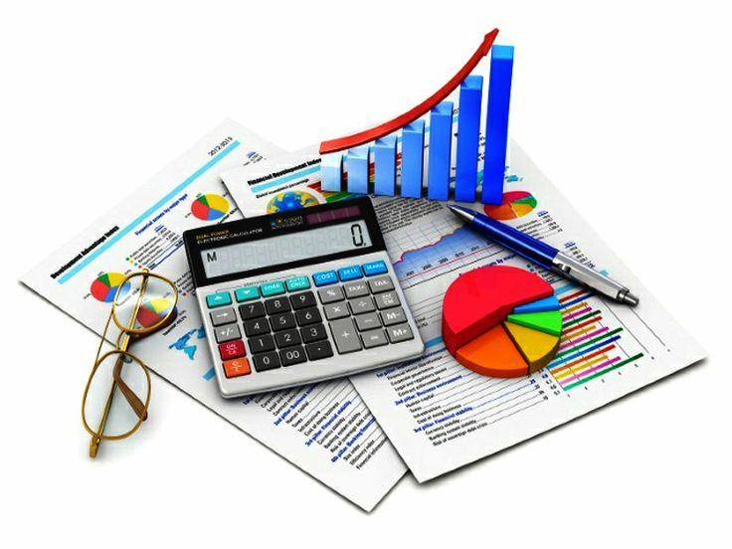
Financial Calculator
A Financial Calculator is a specialized calculator designed to solve problems related to finance, accounting, and business. It includes built-in functions that make complex financial calculations quick and accurate.
Performs time-value-of-money (TVM) calculations:
Present Value (PV)
Future Value (FV)
Interest Rate (I/Y)
Number of Periods (N)
Payment Amount (PMT)
Additional functions include:
Cash flow analysis
Amortization schedules
Depreciation methods
Bond prices and yields

Slide 9
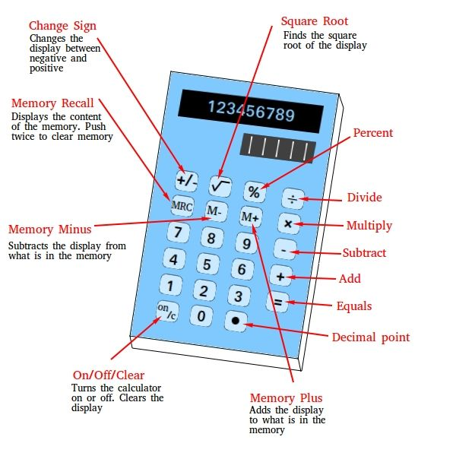
Components of a Calculator
Input: Keypad for entering numbers and operations.
Processor: Executes arithmetic and logic operations.
Memory: Temporarily stores values and results.
Output: LCD or LED display for showing the result.
Power Source: Battery, solar power, or plug-in.

Slide 10

How a Calculator Works
Basic input → Processing unit → Arithmetic logic unit (ALU) → Output
Example: 2 + 3 = 5

Slide 11

Uses of Calculators
Education: Math and science learning at all levels.
Business and Finance: Invoicing, budgeting, interest calculations.
Engineering and Science: Data analysis and complex problem-solving.
Daily Life: Billing, shopping, personal budgeting.
Everyday tasks (bills, taxes, shopping)
Research and scientific work

Slide 12
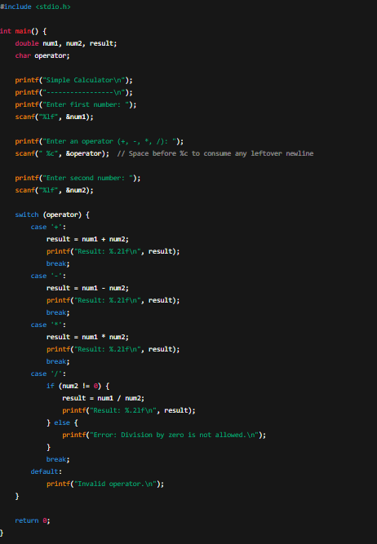
CODE

Slide 13
Learning Outcomes
Learning about calculator usage involves understanding basic functions, knowing when to use them, identifying potential errors, and applying those skills to various mathematical problems. Specifically, learners should be able to perform basic operations like addition, subtraction, multiplication, and division, and apply these skills to more complex calculations, including those involving exponents, logarithms, trigonometric functions, and scientific notation. recognizing and understanding the purpose of buttons on a calculator (e.g., addition, subtraction, multiplication, division, equals).calculator to perform simple arithmetic operations. to solve more complex mathematical problems, including those involving scientific notation, logarithms, and trigonometric functions.calculators in financial planning and other real-world applications.

Slide 14

Future Scope
Integration with AI and voice control
Scientific computing apps
Cloud-based calculators
Programmable and Customizable Devices
Education-Driven Innovation
Sustainability and Accessibility
Integration with STEM Tools

Slide 15
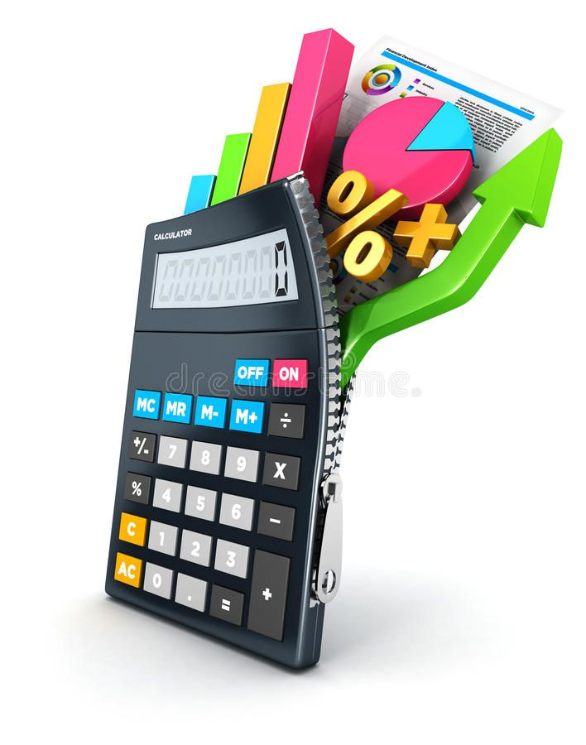
Conclusion
we have developed a calculator for exact real number computation and performed a theoretical analysis of the algorithms and experimented on their implementation.
We began by defining two representations of reals in the range [-1,1] using streams of digits. These were then extended to represent real numbers on the whole real line using a (mantissa, exponent) style representation.
We showed how to convert between these representations, how to convert decimal numbers into a signed binary representation, and how to convert a finite portion of the signed binary representation back into decimal.Algorithms for the basic arithmetic operations were implemented for these representations.
A number of different techniques are used to obtain these algorithms, including exploiting the relationship between the list operation `cons' and numerical average, using certain identities, and analysing of the range of possible values of a stream starting with a given digit or sequence of digits.

